Slide 1
What are Earthquakes?
The shaking or trembling caused by the sudden release of energy
Usually associated with faulting or breaking of rocks
Continuing adjustment of position results in aftershocks

Slide 2
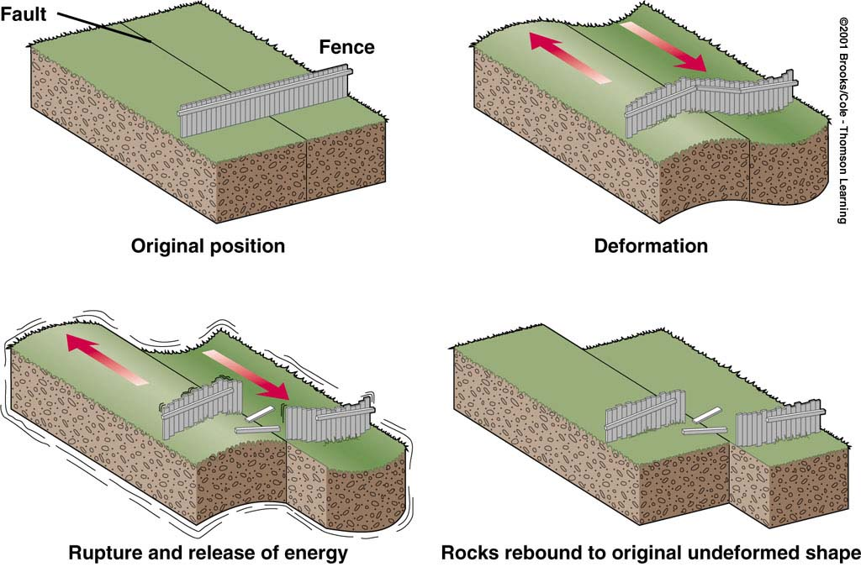
What is the Elastic Rebound Theory?
Explains how energy is stored in rocks
  Rocks bend until the strength of the rock is exceeded
  Rupture occurs and the rocks quickly rebound to an undeformed shape
  Energy is released in waves that radiate outward from the fault

Slide 3
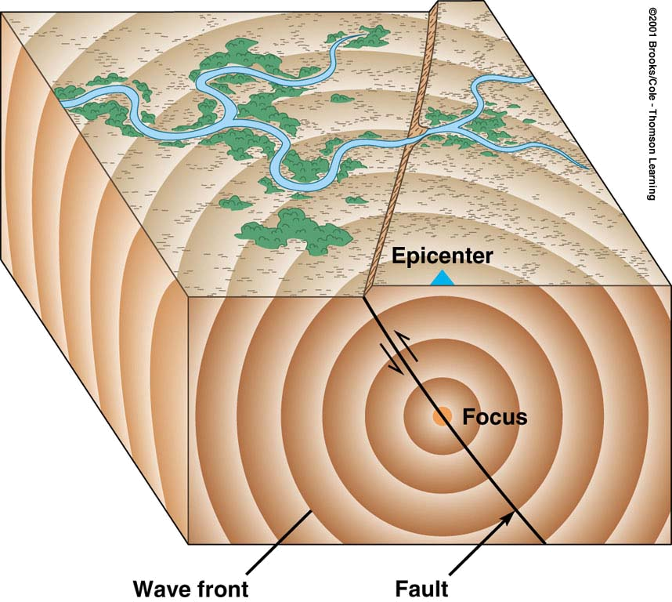
The Focus and Epicenter of an Earthquake
The point within Earth where faulting begins is the focus,
The point directly above the focus on the surface is the epicenter

Slide 4
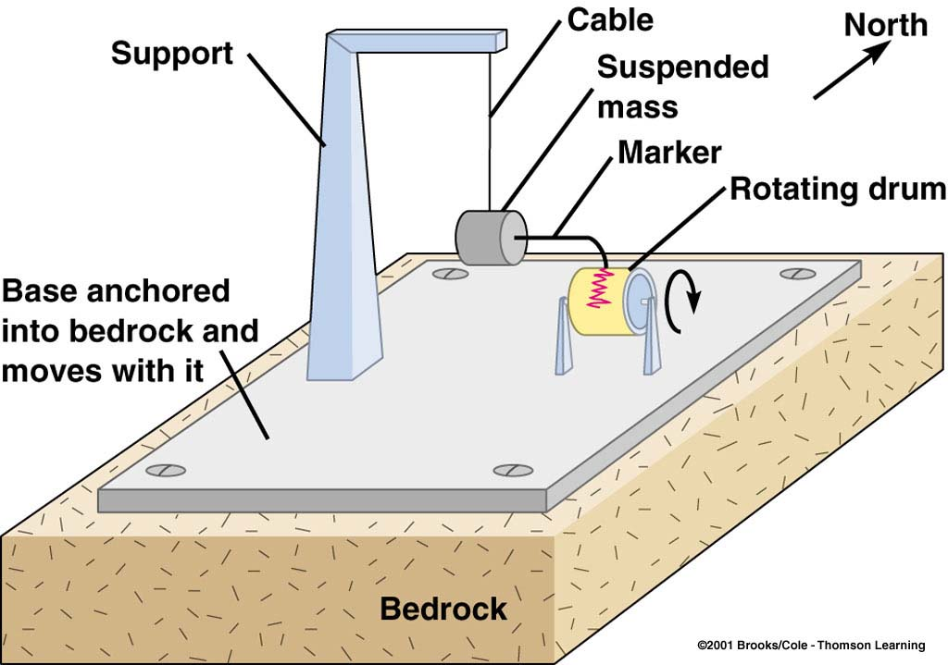
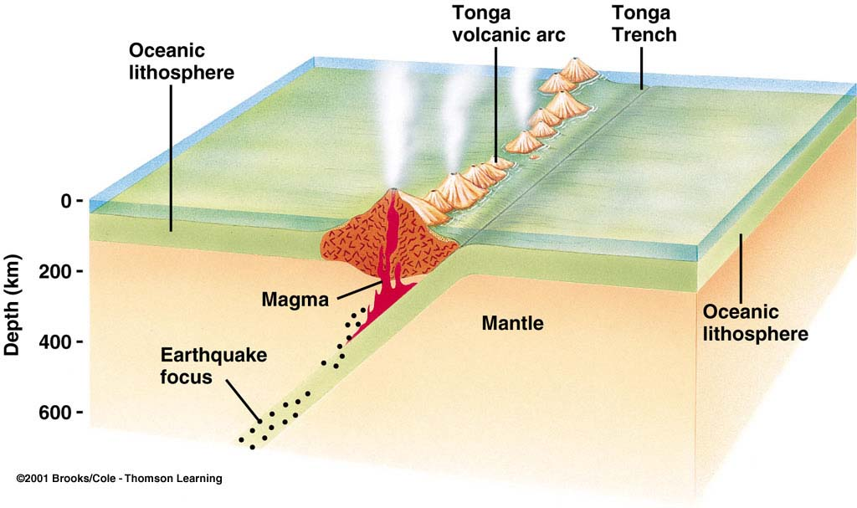
Seismographs record earthquake events
At convergent boundaries, focal depth increases along a dipping seismic zone called a Benioff zone

Slide 5
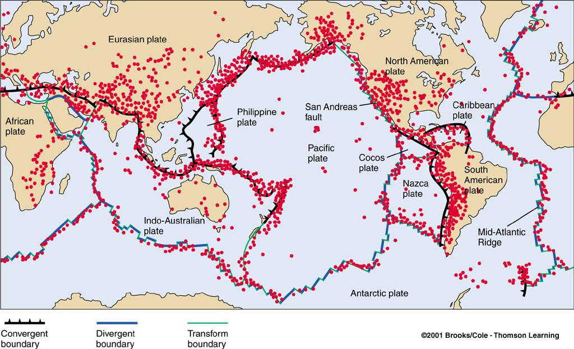
Where Do Earthquakes Occur and How Often?
~80% of all earthquakes occur in the circum-Pacific belt
  most of these result from convergent margin activity
  ~15% occur in the Mediterranean-Asiatic belt
  remaining 5% occur in the interiors of plates and on spreading ridge centers
  more than 150,000 quakes strong enough to be felt are recorded each year

Slide 6
What are Seismic Waves?
Response of material to the arrival of energy fronts released by rupture
Two types:
  Body waves
    P and S
  Surface waves
    R and L

Slide 7
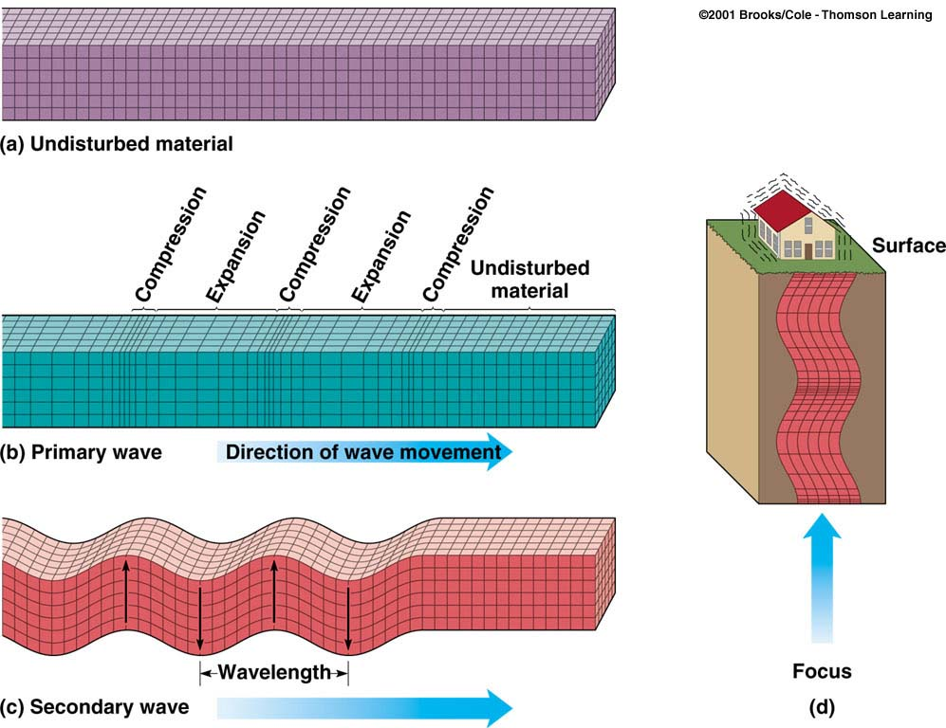
Body Waves: P and S waves
Body waves
  P or primary waves
    fastest waves
    travel through solids, liquids, or gases
    compressional wave, material movement is in the same direction as wave movement
  S or secondary waves
    slower than P waves
    travel through solids only
    shear waves - move material perpendicular to wave movement

Slide 8
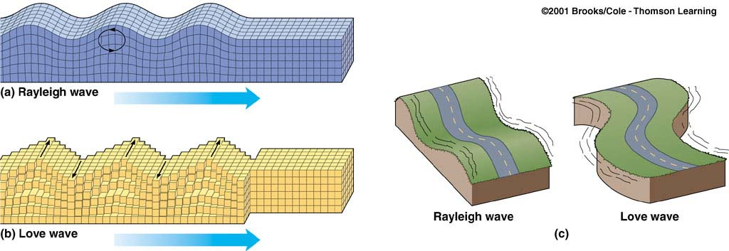
Surface Waves: R and L waves
Surface Waves
  Travel just below or along the ground’s surface
  Slower than body waves; rolling and side-to-side movement
  Especially damaging to buildings

Slide 9
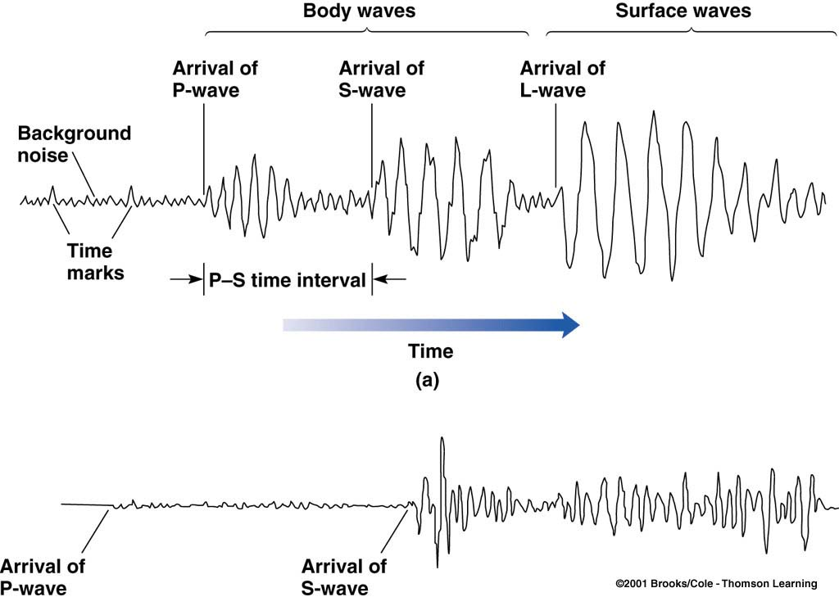
How is an Earthquake’s Epicenter Located?
Seismic wave behavior
  P waves arrive first, then S waves, then L and R
  Average speeds for all these waves is known
  After an earthquake, the difference in arrival times at a seismograph station can be used to calculate the distance from the seismograph to the epicenter.

Slide 10
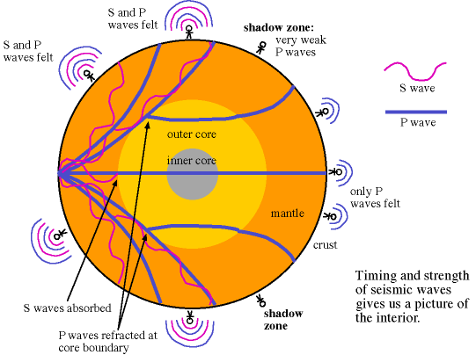
Shadow Zones
The shadow zone is the area of the earth from angular distances of 104 to 140
The shadow zone results from S waves being stopped entirely by the liquid core and P waves being bent (refracted) by the liquid core.
From the lack of S waves and a great slowing of the P wave velocity (by about 40%) it was deduced that the outer core is made of liquid.

Slide 11
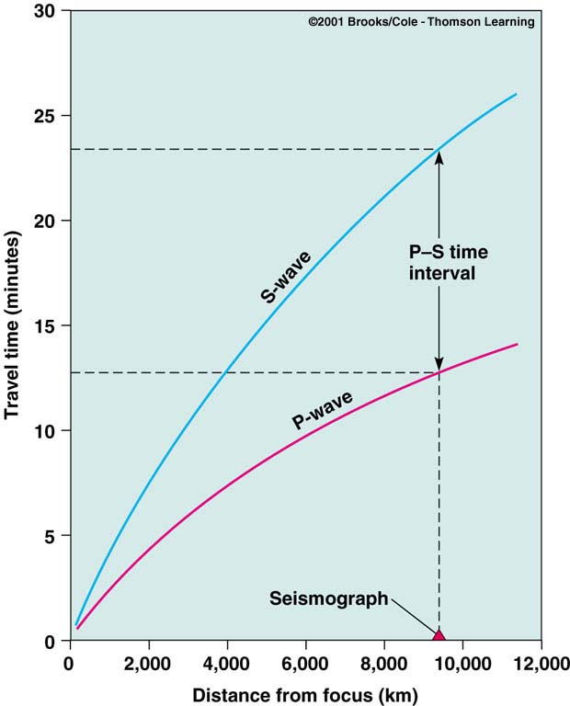
How is an Earthquake’s Epicenter Located?
Time-distance graph showing the average travel times for P- and S-waves. The farther away a seismograph is from the focus of an earthquake, the longer the interval between the arrivals of the P- and S- waves

Slide 12
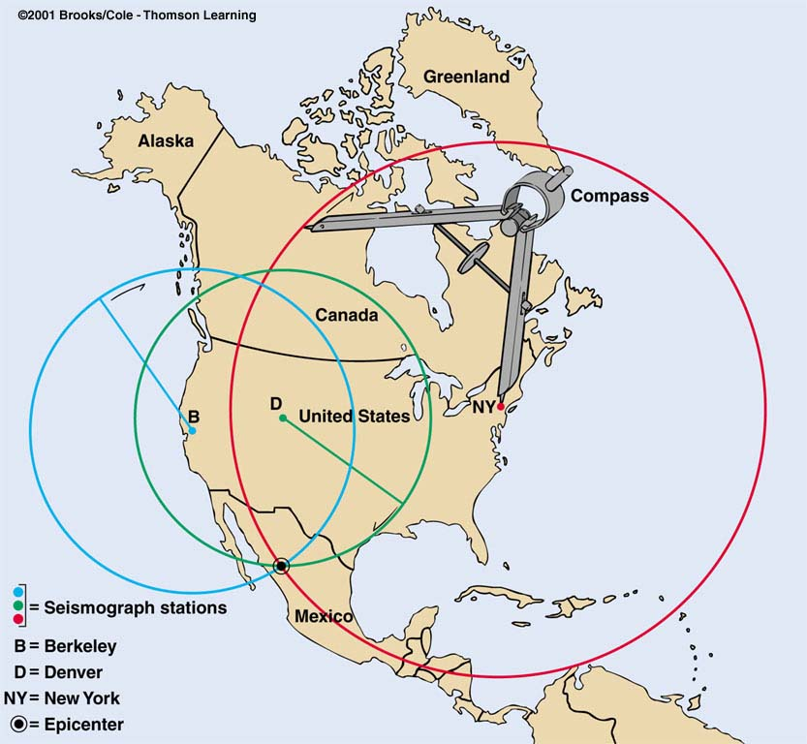
How is an Earthquake’s Epicenter Located?
Three seismograph stations are needed to locate the epicenter of an earthquake
A circle where the radius equals the distance to the epicenter is drawn
The intersection of the circles locates the epicenter

Slide 13
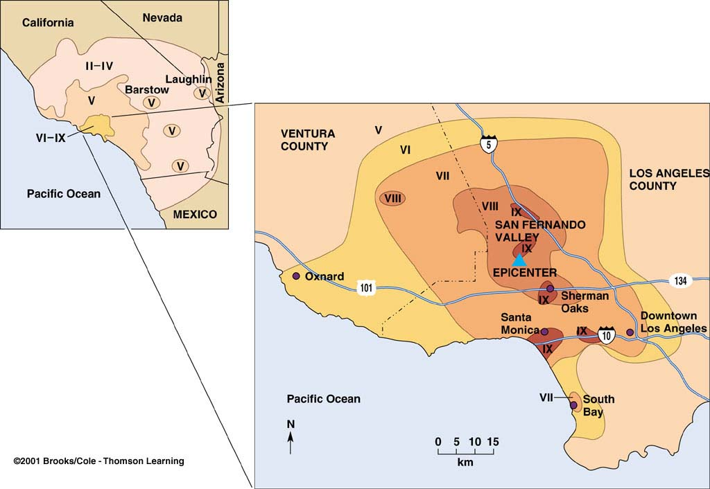
How are the Size and Strength of an Earthquake Measured?
Intensity
  subjective measure of the kind of damage done and people’s reactions to it
  isoseismal lines identify areas of equal intensity
Modified Mercalli Intensity Map
  1994 Northridge, CA earthquake, magnitude 6.7

Slide 14
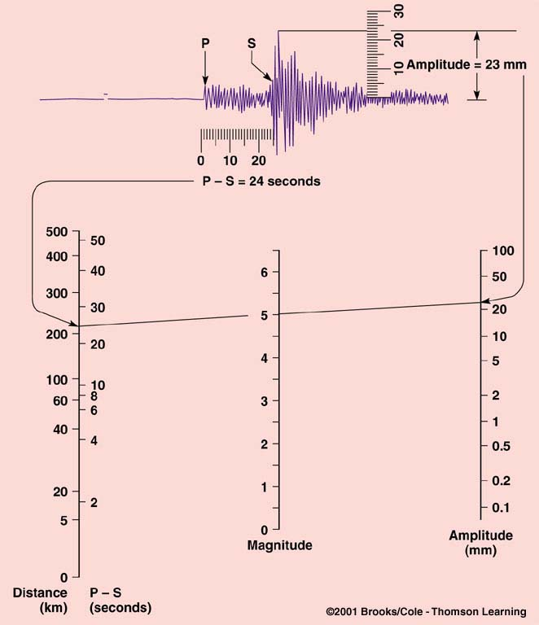
How are the Size and Strength of an Earthquake Measured?
Magnitude
  Richter scale measures total amount of energy released by an earthquake; independent of intensity
  Amplitude of the largest wave produced by an event is corrected for distance and assigned a value on an open-ended logarithmic scale

Slide 15
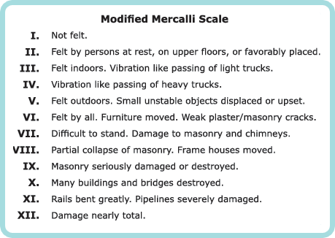
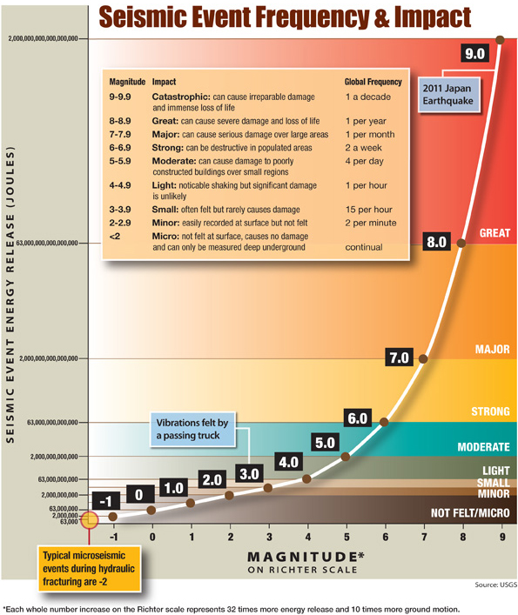
Richter vs Mercalli

Slide 16
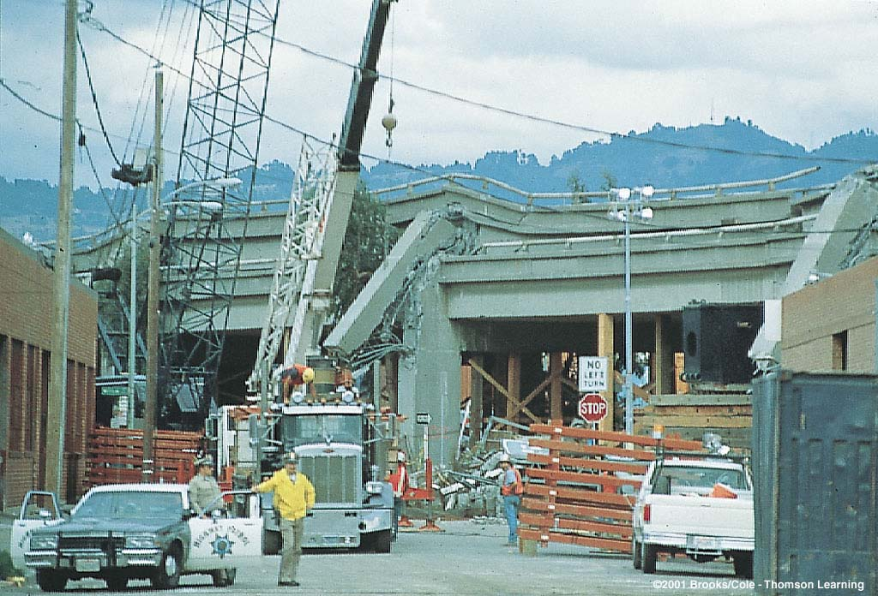
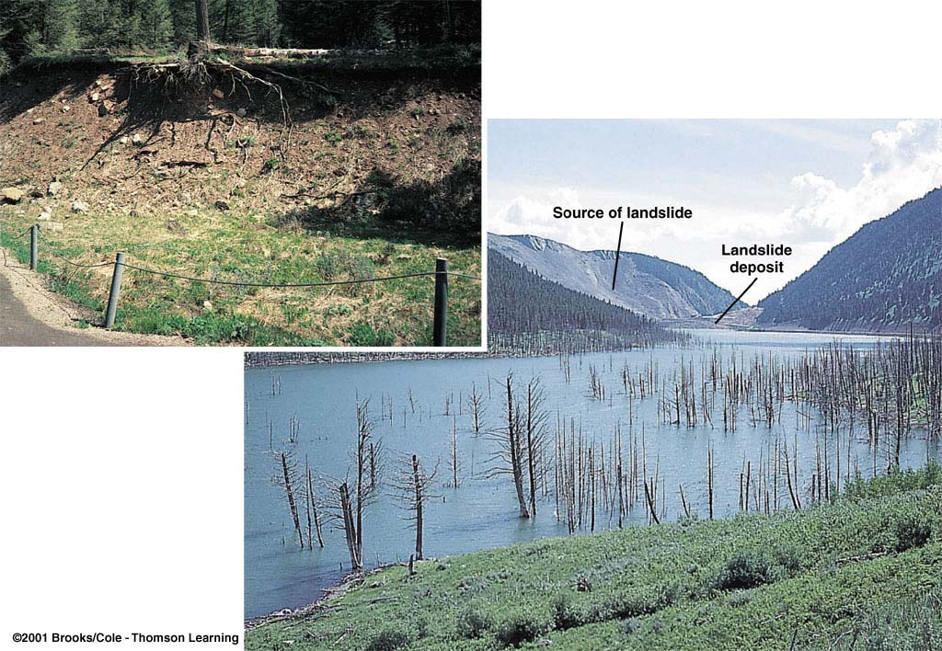
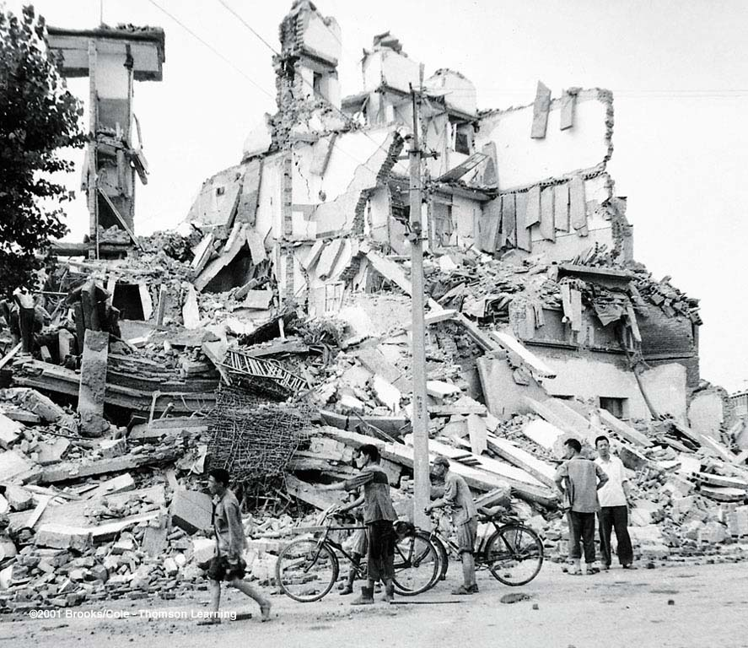
The Economics and Societal Impacts of EQs
Damage in Oakland, CA, 1989
Building collapse
Fire
Tsunami
Ground failure

Slide 17
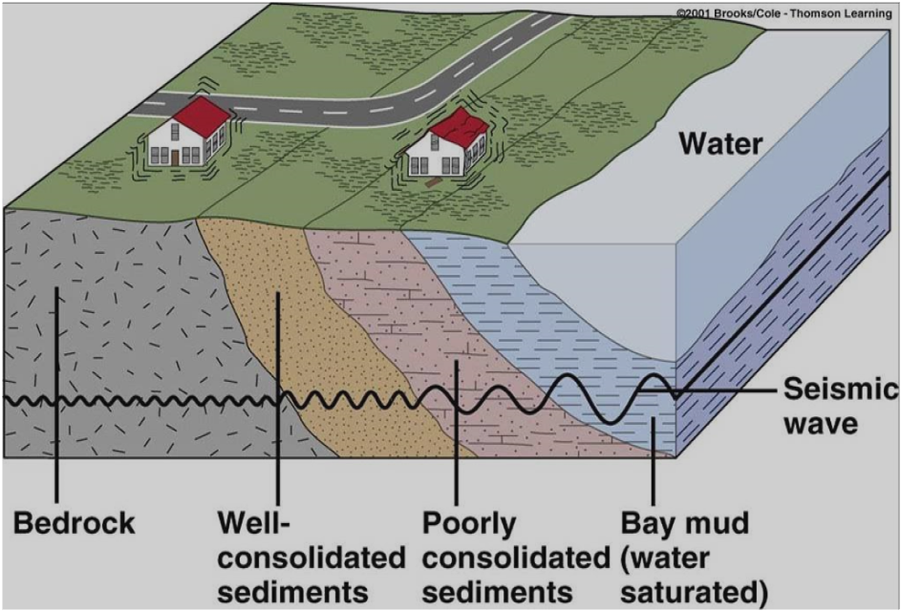
What are the Destructive Effects of Earthquakes?
Ground Shaking
  amplitude, duration, and damage increases in poorly consolidated rocks

Slide 18
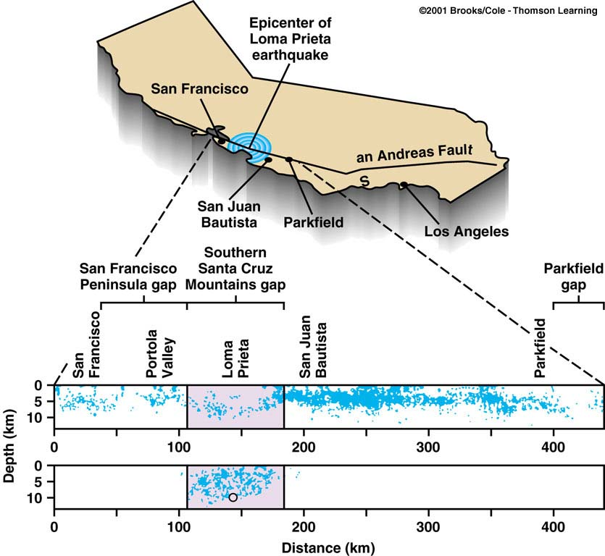
Can Earthquakes be Predicted?
Earthquake Precursors
  changes in elevation or tilting of land surface, fluctuations in groundwater levels, magnetic field, electrical resistance of the ground
  seismic dilatancy model
  seismic gaps

Slide 19
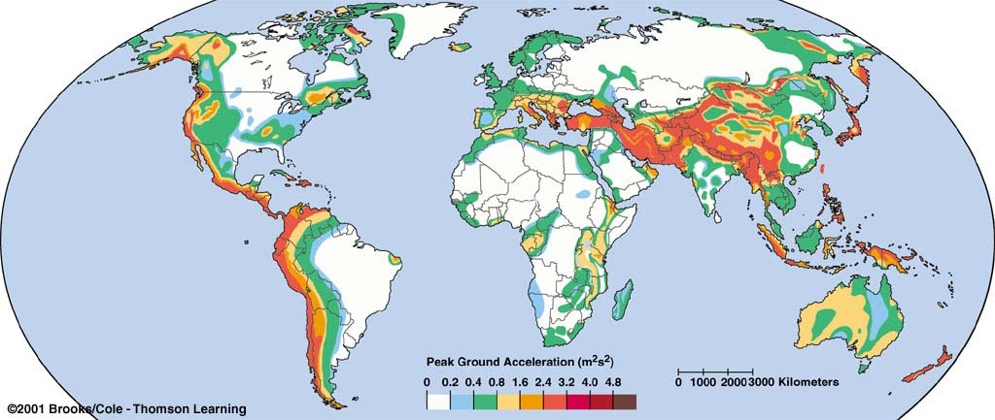
Can Earthquakes be Predicted?
Earthquake Prediction Programs
  include laboratory and field studies of rocks before, during, and after earthquakes
  monitor activity along major faults
  produce risk assessments

Slide 20
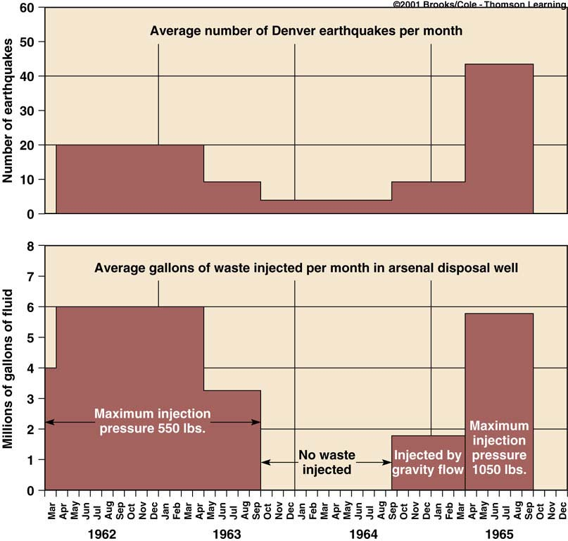
Can Earthquakes be Controlled?
Graph showing the relationship between the amount of waste injected into wells per month and the average number of Denver earthquakes per month
Some have suggested that pumping fluids into seismic gaps will cause small earthquakes while preventing large ones

